Slide 1


Slide 2
Virtual Memory
Background
Demand Paging
Copy-on-Write
Page Replacement
Allocation of Frames
Thrashing
Memory-Mapped Files
Allocating Kernel Memory
Other Considerations
Operating-System Examples

Slide 3
Objectives
To describe the benefits of a virtual memory system
To explain the concepts of demand paging, page-replacement algorithms, and allocation of page frames
To discuss the principle of the working-set model

Slide 4
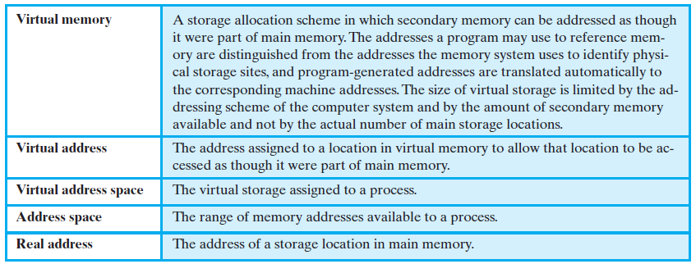
Virtual Memory Terminology

Slide 5
Background
Virtual memory – separation of user logical memory from physical memory.
  Only part of the program needs to be in memory for execution
  Logical address space can therefore be much larger than physical address space
  Allows address spaces to be shared by several processes
  Allows for more efficient process creation
  Need to allow pages to be swapped in and out
Virtual memory can be implemented via:
  Demand paging
  Demand segmentation

Slide 6
Contd..
Problem in Various Memory Management Technique studied in previous chapter.
  The entire process must be loaded into the memory to execute
    Limits the size of a process
    Limits the degree of multiprogramming
Solution:
  Virtual Memory
    Allows the execution of processes that may not be completely in memory
    Increases the degree of multiprogramming

Slide 7

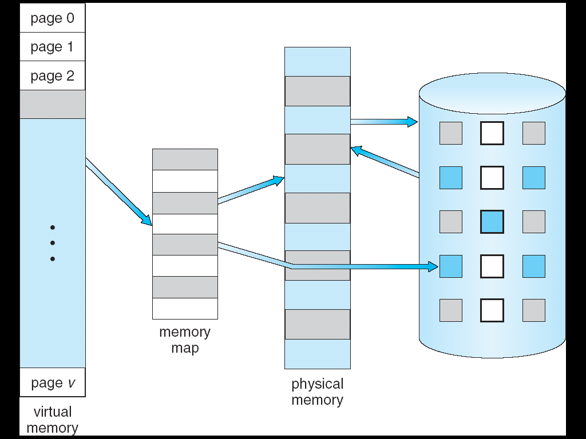
⇒

Slide 8


Part of the Virtual Address Space
→ Sparse

Slide 9

1. Share system library
2. Share memory
3. Share page during process creation

Slide 10
Demand Paging
A demand Paging System is similar to a paging system with Swapping.
Processes reside on secondary memory (which is usually a disk). When execution of process is required, it is swapped into memory.
For this Lazy Swapper is used
Bring a page into memory only when it is needed
  Less I/O needed
  Less memory needed
  Faster response
  More users
Page is needed ⇒ reference to it
  invalid reference ⇒ abort
  not-in-memory ⇒ bring to memory
Lazy swapper – never swaps a page into memory unless page will be needed
  Swapper that deals with pages is a pager

Slide 11
Demand Paging
In Demand Paging, generally Pager is used as it is concerned with the individual pages
  Whenever a process is swapped in,
    Pager guesses the pages that will be used before the process is swapped out again.
    Then, instead of swapping in a whole process, the pager brings only those necessary pages into memory
  Swapper: entire process
  Pager: individual pages of a process

Slide 12

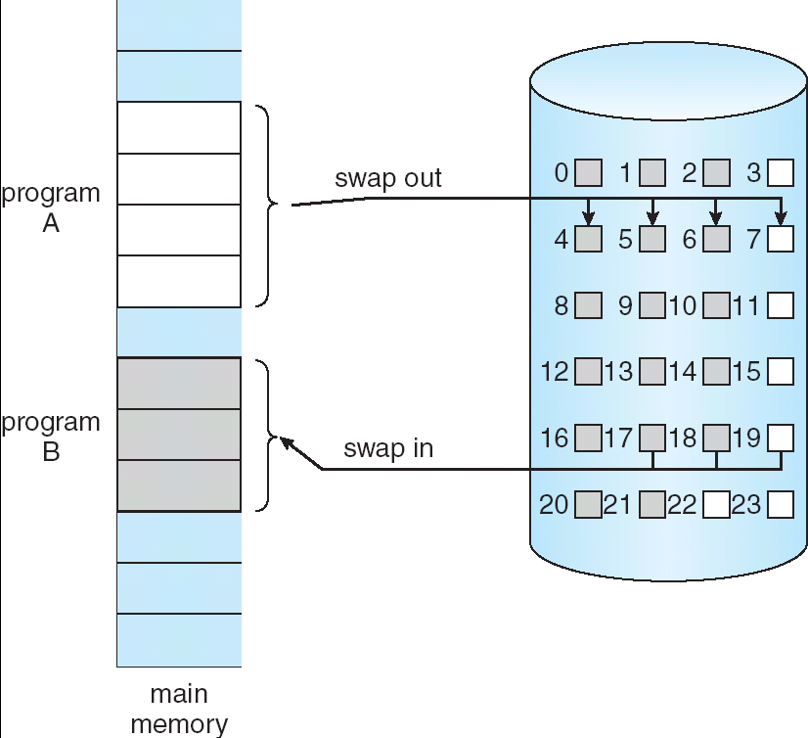
Pager

Slide 13
Valid-Invalid Bit
With each page table entry a valid–invalid bit is associated
(v ⇒ in-memory and legal, i ⇒ not-in-memory or illegal)
“INVALID” means both:
  Not-in-memory: this page has never been loaded from disk before
  Not legal: it is from disk, but-disk copy (original) has been updated
When this bit is set to “valid” this value indicates that the associated page is both legal and in memory.
If bit is set to “invalid” this value indicates that the page either is not valid (that is, not in the logical address space of the process), or is valid but is currently on the disk.

Slide 14
Initially valid–invalid bit is set to i on all entries
Example of a page table snapshot:
During address translation,
if valid–invalid bit in page table entry is i ⇒ Page fault
Frame #
valid-invalid bit
v
v
v
v
i
….
i
i
page table

Slide 15


What happens if the process tries to access a page that was not in Memory?

Slide 16
Handling Page Fault
Step by step procedure to handle page Fault:
  Check an internal table (usually kept with the process control block) for this process, to determine whether the reference was a valid or invalid memory access.
  If the reference was invalid, we terminate the process. If it was valid, but it was brought to the main memory, the page should brought to main memory.
  Now find the free frame (by taking one from the free-frame list).
  Suppose that we schedule a disk operation to read the desired page into the newly allocated frame.
  When the disk read is complete, we modify the internal table kept with the process and the page table to indicate that the page is now in memory.
  Now, we restart the instruction that was interrupted by the illegal address trap. The process can now access the page as though it had always been in memory.

Slide 17



Slide 18
Performance of Demand Paging
For most computer systems memory access time is denoted by Memory access time (ma) = 10 to 200 nanosec
  Let p be the probability of a Page fault rate (p) : 0 ≤ p ≤ 1.0
    if p = 0 no page faults
    if p = 1, every reference is a fault
  Effective access time (EAT) = (1-p) x ma + p x page fault time
  As long as, we have no page faults, the effective access time is equal to memory access time.
Effective Access Time (EAT)
EAT = (1 – p) * memory access
+ p * page fault time ( OS & HW page fault overhead + swap page out if needed + swap page in + OS & HW restart overhead )

Slide 19
Computing Effective access time
To compute the effective access time, we must know how much time is needed to service a page fault. A page fault causes the following sequence to occur:
1. Trap to the Operating system
2. Save the User registers and process state
3. Determine that the interrupt was a page fault.
4.Check that the page reference was legal and determine the location of the page on the disk.
5. Issue a read from the disk to a free frame:
a. Wait in a queue for this device until the read request is serviced.
b. Wait for the device seek and/or latency time.
c. Begin the transfer of the page to a free frame.
6. While waiting, allocate the CPU to some other user (CPU Scheduling optional)
7. Interrupt from the disk (I/O completed)
8. Save the register and the process state for the other user (if step 6 is executed)
9. Determine that the interrupt was from the disk.
10. Correct the page table and other tables to show that the desired page is now in memory.
11. Wait for the CPU to be allocated to this process again
12. Restore the user registers, process state, and new page table, then resume the interrupted instruction.

Slide 20
Demand Paging Example
Memory access time = 200 nanoseconds
Average page-fault service time = 8 milliseconds
EAT = (1 – p) x 200 + p (8 milliseconds)
= (1 – p x 200 + p x 8,000,000
= 200 + p x 7,999,800
If one access out of 1,000 causes a page fault, then
EAT = 8.2 microseconds.
This is a slowdown by a factor of 40!!
To make the performance degradation be less than 10 %, HOW?

Slide 21
Process Creation
There are two techniques made available by virtual memory that enhances performance creating and running process they are:
- Copy-on-Write
- Memory-Mapped Files

Slide 22
Copy-on-Write
Copy-on-Write (COW) allows both parent and child processes to initially share the same pages in memory
All non-modified pages may be shared by the parent and child processes so it can be said that only pages that may be modified need to be marked as Copy-on-Write.
Pages that cannot be modified (i.e. pages containing executable code) may be shared.
COW allows more efficient process creation as only modified pages are copied
It is to be determined that which page is going to be duplicated using Copy-on-Write and where the free pages will be allocated from. Many OS provides pool of free pages for such request.
Operating systems typically allocate these pages using a technique known as zero-fill-on-demand. Zero-fill-on-demand pages have been zeroed-out before being allocated, thus erasing the previous contents of the page.
With copy-on-write, the page being copied will be copied to a zero-filled page.

Slide 23
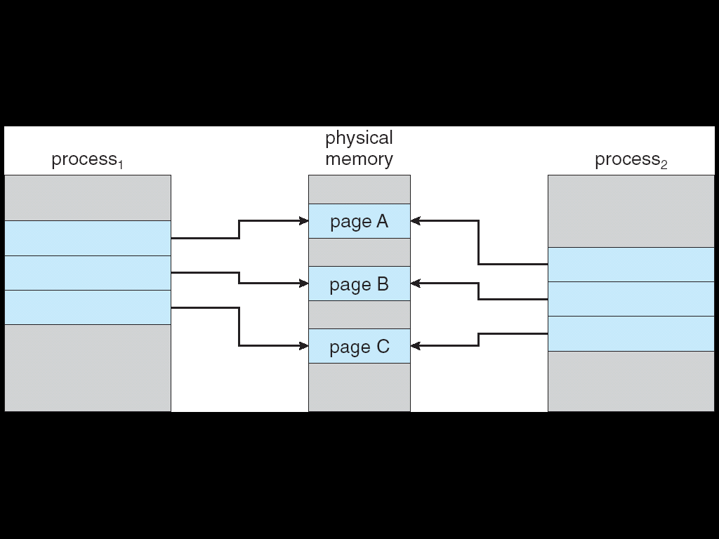
Before Process 1 Modifies Page C

Slide 24
After Process 1 Modifies Page C
Copy of page C

Slide 25
Memory Mapped Files
In Memory Mapping, multiple processes may be allowed to map the same file into the virtual memory of each, to allow sharing of data.
Writes by any of the processes modify the data in virtual memory and can be seen by all others that map the same section of the file.
The memory-mapping system calls can also support copy-on-write functionality, allowing processes to share a file in read-only mode, but to have their own copies of any data they modify, so that access to the shared data is coordinated.

Slide 26
Diagram representing Memory Mapped file
1
1
1
2
3
2
3
3
2
Process A virtual memory
Process B virtual memory
Physical memory
1
2
3
Disk File

Slide 27
Replacement Policy, if there is no free frame?
In our study so far, the page fault rate has not been a serious problem, because each page has faulted at most once, when it is first referenced, to determine this is a tedious task as many concepts are involved:
How many page frames are to be allocated to each active process
Whether the set of pages to be considered for replacement should be limited to those of the process that caused the page fault or encompass all the page frames in main memory
Among the set of pages considered, which particular page should be selected for replacement
What should be the Algorithm for choosing target page for replacement
What should be the Goal – minimum number of page faults.
Same page may be brought into memory several times during run.
The Page replacement Approach targets the above issues.

Slide 28
Page Replacement
Prevent over-allocation of memory by modifying page-fault service routine to include page replacement
Use modify (dirty) bit to reduce overhead of page transfers – only modified pages are written to disk
Page replacement completes separation between logical memory and physical memory – large virtual memory can be provided on a smaller physical memory
Dirty
Invalid
A
1. read
A
A
1. read
A
2. modified
2. modified

Slide 29


What happens if NO free frame?
Terminate the process
Swap out the process
Find a victim page,
write the page on swap space
Then, copy B to the frame

Slide 30
Basic Scheme for Page Replacement
Page Replacement takes the following approach:
Conditions:
  If no frame is free, we find one that is currently being used and free it.
  The frame can be freed by writing its contents to swap space, and changing the page table (and all other tables) to indicate that the page is no longer in memory.
  The freed frame to hold the page for which the process faulted.
Step-by-step Approach:
  Find the location of the desired page on the disk.
  Find a free frame:
    If there is free frame, use it
    If there is no free frame, use a page-replacement algorithm to select a victim frame.
    Write a victim page to the disk; change the page and frame tables accordingly.
  Read the desired page to the disk; change the page and frame tables accordingly
  Restart the user process.

Slide 31



Slide 32
Page Replacement Algorithms
Requirement is lowest page-fault rate
Evaluate algorithm by running it on a particular string of memory references (reference string) and computing the number of page faults on that string
In all our examples, the reference string is
1, 2, 3, 4, 1, 2, 5, 1, 2, 3, 4, 5
More No. of frames more the page fault, this assumption is not always true in case of Belady’s anomaly.
Unexpected result comes in Belady’s anomaly

Slide 33


Generally more no. of frames more page fault

Slide 34
First-In-First-Out (FIFO) Algorithm
Reference string: 1, 2, 3, 4, 1, 2, 5, 1, 2, 3, 4, 5
3 frames (3 pages can be in memory at a time per process)
4 frames
1 2 3 4 1 2 5 1 2 3 4 5
1
1
1
4
4
4
5
5
5
2
2
2
1
1
1
3
3
9 page faults
3
3
3
2
2
2
4
1 2 3 4 1 2 5 1 2 3 4 5
1
1
1
1
5
5
5
5
4
4
2
2
2
2
1
1
1
1
5
10 page faults
3
3
3
3
2
2
2
2
4
4
4
4
3
3
3

Slide 35



Slide 36
Optimal Algorithm
Replace page that will not be used for longest period of time. (4 frames example)
Use the longest distance forward to replace the page
1 will be needed at= 1,5, 8, 2 will be needed at = 2, 6 3 will be needed at= 3,10 4 will be needed at = 4, 11 and 5 will be required at = 7, 12
How do you know this?
Used for measuring how well your algorithm performs
1 2 3 4 1 2 5 1 2 3 4 5
1
1
1
1
1
4
2
2
2
2
2
6 page faults
3
3
3
3
4
5
5

Slide 37
Least Recently Used (LRU) Algorithm
Replace the page that has not been used for the longest period time
In this see the more backward distance, if page has to be replaced.
When 5 is to be replaced, seeing the backward distance 2 is 1 distance away, 1 is 2 distance away, 4 is 3 distance away and 3 is 4 distance away, so choose 3 to be replaced with 5.
1 2 3 4 1 2 5 1 2 3 4 5
1
1
1
1
1
1
1
5
2
2
2
2
2
2
2
8 page faults
3
3
5
5
4
4
4
4
3
3
3

Slide 38
LRU Algorithm (Cont.)
Counter implementation
  Every page entry has a counter; every time page is referenced through this entry, copy the clock into the counter
  When a page needs to be changed, look at the counters to determine which are to change
1 2 3 4 1 2 5 1 2 3 4 5
1
1
1
1
1
1
1
1
1
1
1
5
1
2
3
4
1
2
3
1
2
3
4
1
2
2
2
2
2
2
2
2
2
2
2
1
2
3
4
1
2
3
1
2
3
4
8 page faults
3
3
3
3
5
5
5
5
4
4
1
2
3
4
1
2
3
4
1
2
4
4
4
4
4
4
3
3
3
1
2
3
4
5
6
1
2
3
Page
Fault
Page
Fault
Page
Fault
Page
Fault
Page
Fault
Page
Fault
Page
Fault
Page
Fault
Lookup counter to find oldest one

Slide 39
LRU Algorithm (Cont.)
Stack implementation – keep a stack of page numbers in a double link form:
  Page referenced:
    move it to the top
    requires 6 pointers to be changed
  No search for replacement
  If n frames is used for LRU, it requires n+1 frames.

Slide 40
1
1
1
1
1
1
1
5
2
2
2
2
2
2
2
Page
4
3
3
5
5
4
4
4
3
3
3
1 2 3 4 1 2 5 1 2 3 4 5
5
1
2
3
4
4
Stack
4
1
2
2
5
1
2
3
2
3
3
4
1
1
2
5
1
2
1
2
2
2
3
4
4
4
4
5
1
5
1
1
1
1
2
3
3
3
3
4
5
3

Slide 41
LRU Approximation Algorithms
Reference bit
  With each page associate a bit, initially = 0
  When page is referenced bit set to 1
  Replace the one which is 0 (if one exists)
    We do not know the order, however
Additional reference bit
  Victim: the frame indicated by the page entry whose 8-bit byte (reference byte) value is the smallest one.
  Each page table entry has reference-byte (8-bit byte)
  At regular interval (e.g. 100 milliseconds), OS (timer interrupt) write
    The most recent reference bit into the high-order bit of 8-bit byte
    Then, shifting the other bits right 1 bit, discard low-order bit
    i.e., the history of page accesses during the last eight time intervals
    E.g. 11000100 has been used more recently than 01110111

Slide 42
Second-chance page replacement
Second chance
  Victim: The first page in the FIFO queue whose reference-bit is zero
  FIFO queue = Circular queue
    The tail of the queue points to the head of the queue
  To find the victim
    OS scans the queue from the last stop point in a circular fashion
    Until it finds a page whose current reference bit is zero
    As the pointer advances, it sets the reference bits to zero
  Worst case (All bits are 1) ➔ FIFO

Slide 43



Slide 44
Counting Algorithms
Keep a counter of the number of references that have been made to each page
LFU Algorithm: The least frequently used (LFU) page –replacement algorithm requires that the page with smallest count be replaced
MFU Algorithm: The most frequently used (MFU) page-replacement algorithm is based on the argument that the page with the smallest count was probably just brought in and has yet to be used

Slide 45
Allocation of Frames
Two major allocation schemes
  fixed allocation
  priority allocation

Slide 46


Fixed Allocation
Equal allocation – For example, if there are 100 frames and 5 processes, give each process 20 frames.
Proportional allocation – Allocate according to the size of process

Slide 47
Priority Allocation
Use a proportional allocation scheme using priorities rather than size
High priority process – give more memory – finish early

Slide 48
Global vs. Local Allocation
With multiple processes competing for frames, we can classify page-replacement algorithms into two broad categories:
Global replacement – allows a process to select a replacement frame from the set of all frames, even if that frame is currently allocated to some other process; one process can take a frame from another.
Local replacement – requires that each process select from only its own set of allocated frame. In this, the number of frames allocated to a process does not change.

Slide 49
Thrashing
If the process does not have enough no. of frames, it will quickly give page fault.
It must replace some pages. However, since all its pages may be in active use, it must replace pages that will be needed again.
Consequently, it quickly faults again, and again, and again.
The process continues to fault, replacing pages for which it then faults and brings back in right away.
This high paging activity is called thrashing. A process is thrashing if it is spending more time paging than executing.
In thrashing, the page-fault rate is very high. This leads to:
  low CPU utilization
  operating system thinks that it needs to increase the degree of multiprogramming
  another process added to the system
Thrashing ≡ a process is busy swapping pages in and out

Slide 50

Thrashing (Cont.)
In below fig. CPU utilization is plotted against the degree of multiprogramming.
As, the degree of multiprogramming increases, CPU utilization also increases.
If the multiprogramming is increased even further, thrashing sets in and CPU utilization drops sharply.
To increase CPU utilization and stop thrashing, we must decrease degree of multiprogramming.
Thrashing

Slide 51
Operating System Examples
Windows XP
Solaris

Slide 52
Windows XP
Uses demand paging with clustering. Clustering brings in pages surrounding the faulting page.
Processes are assigned working set minimum and working set maximum
Working set minimum is the minimum number of pages the process is guaranteed to have in memory
A process may be assigned as many pages up to its working set maximum
When the amount of free memory in the system falls below a threshold, automatic working set trimming is performed to restore the amount of free memory
Working set trimming removes pages from processes that have pages in excess of their working set minimum

Slide 53
Solaris
Maintains a list of free pages to assign faulting processes
Lotsfree – threshold parameter (amount of free memory) to begin paging
Desfree – threshold parameter to increasing paging
Minfree – threshold parameter to being swapping
Paging is performed by pageout process
Pageout scans pages using modified clock algorithm
Scanrate is the rate at which pages are scanned. This ranges from slowscan to fastscan
Pageout is called more frequently depending upon the amount of free memory available

Slide 54


